Slide 1

Introduction to Parkinson's Disease
Parkinson's disease is a chronic, progressive neurological disorder that primarily affects the motor system. It is characterized by the gradual loss of dopaminergic neurons in the brain, leading to tremors, muscle stiffness, and impaired movement.

Slide 2
Symptoms and Progression
Early symptoms include tremors, rigidity, and bradykinesia (slowness of movement).
As the disease progresses, postural instability, gait disturbances, and cognitive impairments may develop.
Parkinson's is marked by a gradual worsening of motor symptoms, often over many years, as more dopamine-producing neurons are lost.

Slide 3
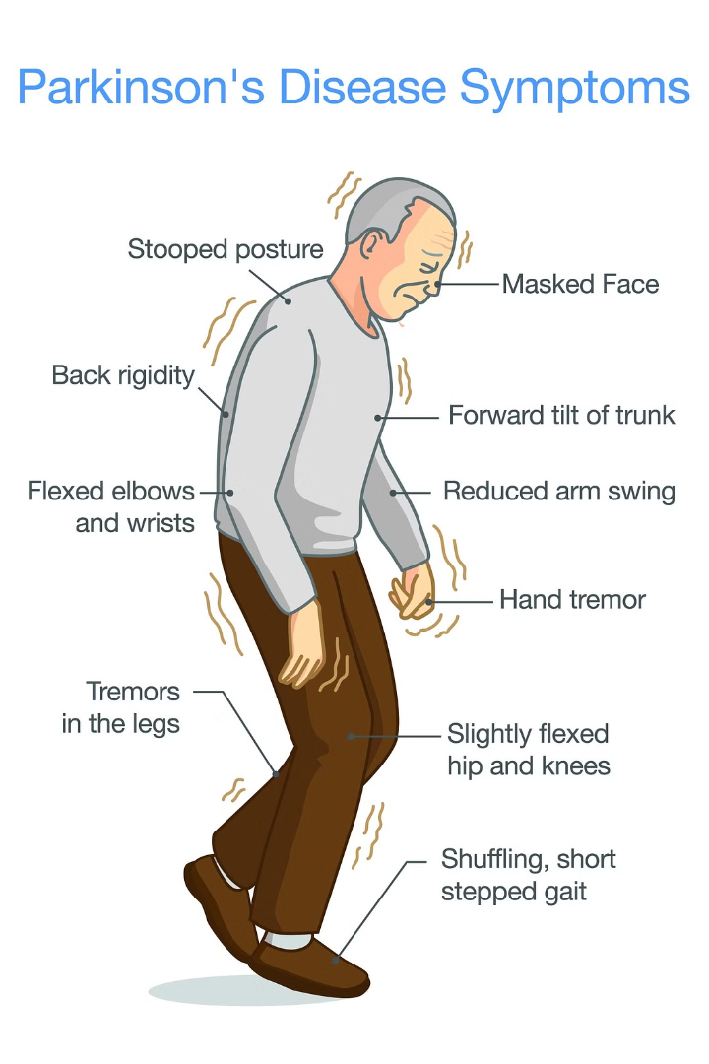
Diagnosis and Assessment
Clinical evaluation by a neurologist, including a detailed medical history and physical examination.
Neuropsychological testing to assess cognitive function, mood, and behavior changes associated with Parkinson's.
Dopamine transporter imaging, such as SPECT or PET scans, to measure the loss of dopaminergic neurons in the brain.

Slide 4
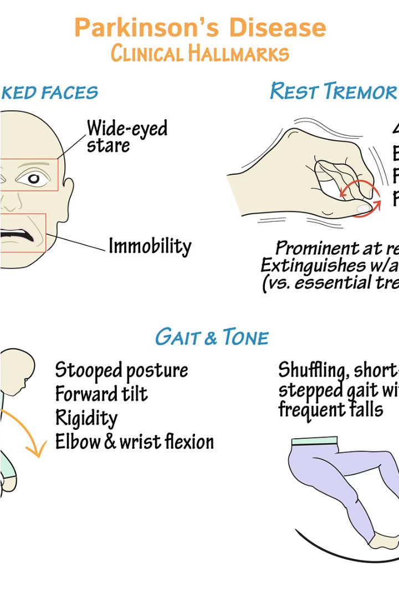
Neurological Examination
A comprehensive neurological exam is crucial in diagnosing Parkinson's disease. The examiner will assess motor function, reflexes, and coordination to identify characteristic signs like tremors, rigidity, and bradykinesia.
The exam may also involve testing sensory perception, cranial nerve function, and cognitive abilities to rule out other neurological conditions.

Slide 5
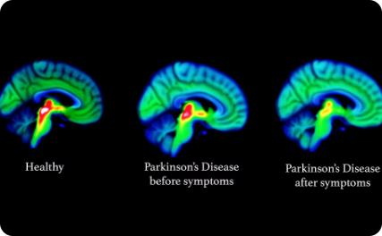
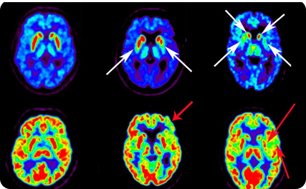
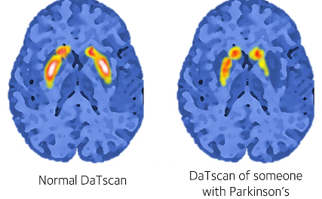
Imaging Techniques
Magnetic Resonance Imaging (MRI)
Positron Emission Tomography (PET)
Dopamine Transporter Imaging
MRI scans can detect structural changes in the brain associated with Parkinson's, such as reduced volume in certain regions. This helps rule out other conditions and supports the clinical diagnosis.
PET scans measure the activity of dopamine-producing neurons, allowing clinicians to visualize the progressive loss of these cells as Parkinson's advances. This provides an objective assessment of disease stage.
DaTscans and other dopamine transporter imaging techniques can detect the depletion of dopamine neurons, aiding early Parkinson's diagnosis before significant motor symptoms appear.

Slide 6
Biomarkers and Genetic Factors
Biomarkers
Genetic Links
Cerebrospinal Fluid
Blood-based Markers
Researchers are exploring biological markers, or biomarkers, that can help detect Parkinson's disease earlier. These include changes in protein levels, metabolites, and gene expression patterns in the body.
While Parkinson's is primarily a sporadic disorder, certain genetic mutations have been linked to increased risk. Identifying these genetic factors can aid in earlier diagnosis and personalized treatment approaches.
Analysis of cerebrospinal fluid can reveal Parkinson's-associated proteins like alpha-synuclein and DJ-1, which may serve as valuable diagnostic biomarkers when combined with other clinical assessments.
Blood tests that measure inflammatory markers, oxidative stress indicators, and other Parkinson's-related molecules hold promise for non-invasive, cost-effective screening and early detection of the disease.

Slide 7
Early Detection and Screening
Prodromal Symptoms
1
Early non-motor symptoms like anosmia (loss of smell), REM sleep behavior disorder, and constipation can precede the onset of Parkinson's motor signs by years, enabling earlier detection.
2
Genetic Testing
Genetic screening for known Parkinson's risk mutations allows identification of individuals predisposed to the disease, facilitating proactive monitoring and preventative interventions.
Biomarker Panels
3
Comprehensive biomarker panels analyzing proteins, metabolites, and other molecules in blood, cerebrospinal fluid, or skin can flag early Parkinson's pathology prior to overt symptoms.

Slide 8

Challenges in Diagnosis
Diagnosing Parkinson's disease can be challenging, as its early symptoms often resemble those of other neurological conditions. The progressive nature of the disease and the lack of a definitive diagnostic test add to the complexity.
Atypical Parkinson's syndromes, such as multiple system atrophy and progressive supranuclear palsy, can further complicate the diagnostic process, as they share similar symptoms with Parkinson's disease.
Additionally, the heterogeneity of Parkinson's, with varying degrees of motor and non-motor symptoms, makes it difficult to establish a standardized diagnostic approach.

Slide 9
Emerging Technologies
1
Wearable Sensors
2
Artificial Intelligence
Advanced wearable devices can continuously monitor movement, tremors, and other Parkinson's-related symptoms, enabling earlier detection and remote disease tracking.
AI-powered analysis of speech patterns, facial expressions, and gait can help identify subtle Parkinson's markers before clinical diagnosis, aiding early intervention.
3
Bioelectronic Medicine
4
Digital Biomarkers
Implantable neural interfaces and deep brain stimulation devices show promise in managing Parkinson's motor symptoms and potentially slowing disease progression.
Innovative digital tools that leverage smartphone sensors and mobile apps can passively collect data to detect Parkinson's signatures in everyday activities.

Slide 10
Importance of Early Intervention
Slower Progression
Better Symptom Management
Early detection and treatment can help slow the progression of Parkinson's disease, preserving motor function and quality of life for longer.
Prompt intervention allows for more effective management of initial motor and non-motor symptoms, improving daily functioning and independence.
Neuroprotective Potential
Personalized Care
Emerging therapies may have the ability to slow or even halt the underlying neurodegeneration in Parkinson's if administered early enough.
Early diagnosis enables a tailored, multidisciplinary approach to treatment, addressing the unique needs and symptoms of each individual patient.

